Slide 1
Communications kit
Have your say on the NSW Strategic Plan for Children and Young People 2027-2030
April 2026

Slide 2
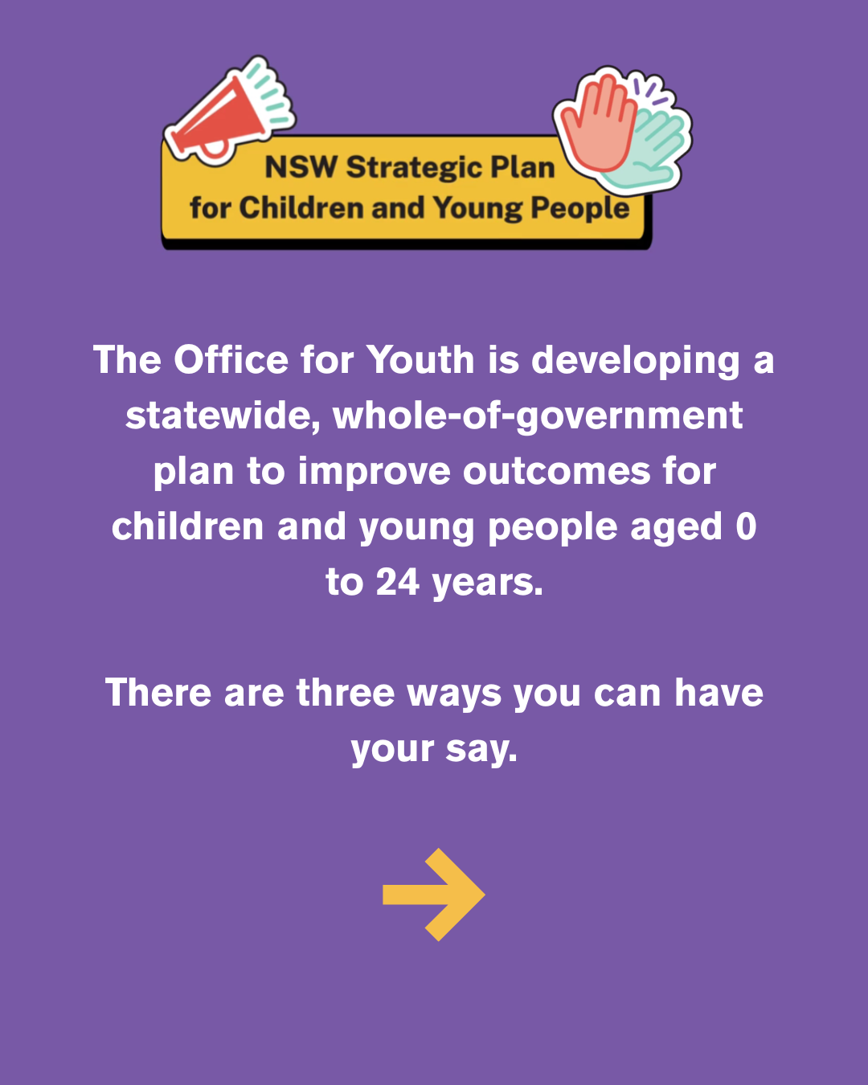
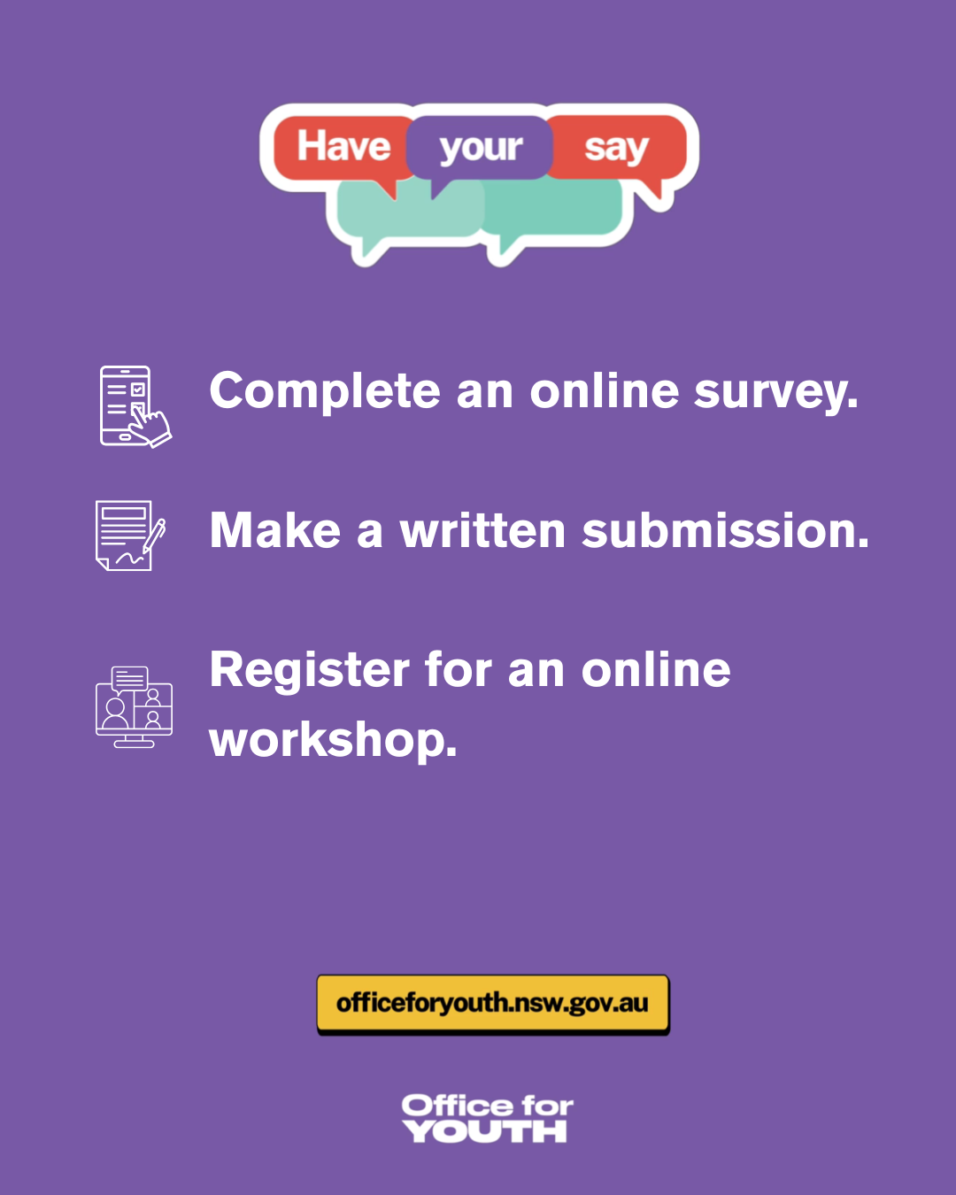
Social media tiles

Slide 3
Social media caption
Have your say: NSW’s new Strategic Plan for Children and Young People 2027-2030
The Office for Youth, led by the Advocate for Children and Young People is developing a statewide, whole-of-government plan to improve outcomes for children and young people aged 0 to 24 years.
The Plan will focus on systemic issues impacting children and young people, and make sure that their voices are included in decision-making. You can provide feedback in any of the following ways:
Complete the short online survey.
Make a written submission.
Register for an online workshop if you are aged 14 to 24 years old.
Visit www.officeforyouth.nsw.gov.au to find out more.

Slide 4
Sector EDM
Have your say: NSW’s new Strategic Plan for Children and Young People 2027-2030
The NSW Government is developing a statewide, whole-of-government plan to improve outcomes for children and young people aged 0 to 24 years.
The Plan will focus on systemic issues impacting children and young people, and make sure their voices are included in decision-making.
We invite you to provide feedback by 30 June 2026:
Complete the online survey
Make a formal written submission on behalf of your organisation
Register for an online workshop if you are aged 14 to 24
For more information about the plan: www.officeforyouth.nsw.gov.au/strategic-plan-2027-30

Slide 5
Children and young people EDM
What would make your life better?
You’re invited to give feedback on how to make NSW a better place for children and young people.
The ideas and experiences you share will help the NSW Office for Youth and other government agencies make priorities in the coming years.
You can provide feedback in any of the following ways by 30 June 2026:
Complete the online survey
Register for an online workshop
For more information about the plan: www.officeforyouth.nsw.gov.au/strategic-plan-2027-30

Slide 6

EDM banner

